Slide 1
ANTIPSYCHOTICS
Dr Anuradha Dassanayake

Slide 2
Objectives
Types of antipsychotics
Indications for use of antipsychotics
Adverse effects of antipsychotics

Slide 3
Clinical scenario 1
A 35 year old man was admitted to the medical casualty with Dengue Fever. Next day he has assaulted the nurse who wanted to take his blood in the morning and threatens to jump out of the 5th floor unless he is discharged immediately.

Slide 4
Clinical scenario 2
A 22 year old medical student has become aggressive in the hostel and refused attending lectures. He informs his batch mates that his girl friends brother is hiding in the faculty to kill him.

Slide 5
Cilnical scenario 3
An 80 year old has become aggressive at night and disturbs others in the house hold. He has poor sleep. He starts walking at night and one day found loitering on the road and brought home by the police.

Slide 6
Case 4
A 29 year old girl presented with severe icterus. She had received medications for Post Partum psychosis(Puerperal psychosis) 3 weeks ago.

Slide 7
Case 5.
Head priest of a temple started preaching abnormally. He became aggressive and violent.

Slide 8
Major tranquilizers,Neuroleptics
Similar names used for antipsychotics
  Major tranquilizers
  Neuroleptics (Drugs with prominent EPS)

Slide 9
Therapeutic effects
Emotional quietening
Indifference
Psychomotor slowing

Slide 10
Indications for use
Acute and chronic psychoses
  Mania
  Schizophrenia
Acute organic cofusional states
  Alcohol withdrawal
  Drug intoxication
Chronic organic conditions
  Dementia
Treatment of vomiting( promethazine)

Slide 11
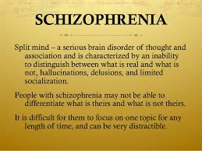

Slide 12
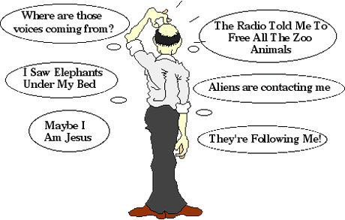

Slide 13
Typical antipsychotics
Phenothiazines
  Chlorpromazine
  Trifluoperazine
Butyrophenones
  Haloperidol
Thioxanthenes
  Flupenthixol

Slide 14
Atypical antipsychotics
Clozapine
Olanzapine
Risperidone
Quetiapine
Aripiprazole

Slide 15
Mechanisms of action
All antipsychotics are Dopamine receptor antagonists
Also blocks 5HT receptors( more atypical)
takes days or weeks to work

Slide 16
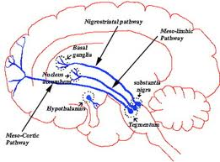

Slide 17
Atypical antipsychotics
Less incidence of extrapyramidal side effects
Effective against negative symptoms
effective against resistant patients –Resulted in the release of many longstanding patients from mental asylums worldwide.

Slide 18
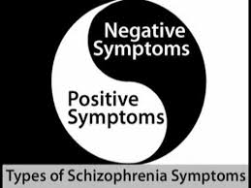

Slide 19
Indications
Acute psychotic states-eg Alcohol withdrawal
Schizpohrenia
Mania
pain in terminal illness
Intractable Hiccup
Dementia/elderly
ADHD

Slide 20
Phenothiazines -Chlorpromazine
Dopamine receptor antagonist
Also have anticholonergic and anti histamine properties and antiemetic properties

Slide 21
Kinetic data
T1/2 35 hours
substantial hepatic first pass metabolism

Slide 22
Atypical antipsychotics
Used as first line treatment
less side effects
Agranulocytosis is reported with clozapine. Monitor blood counts when you start treatment.
significant of metabolic side effects(Weight gain/IGT)mainly with olanzapine

Slide 23
Adverse effects
Extrapyramidal side effectrs .Tremor Drug induced Parkinsonisim, Tardive dyskinesia
Sedation
Anticholinergic effects
Galactorrhoea and amenorrhoea
Photosensitive rashes
Cholestatic jaundice
Neuroleptic malignant syndrome

Slide 24
Injectable preparations
40% of schizophrenics do not take regular medications
depot preparations Flupenthixol and Fluphenazine are available
Can be given at 3-4 week intervals

Slide 25
Further reading
Drug induced Parkinsonism
Action of dopamine on various pathways in the brain
  Basal ganglia
  Hypothalamus
  CTZ

Slide 26
Summary
Typical
Atypical
Indications for use
Adverse effects

